Slide 1
Present simple tense
When do we use the simple present tense in English?

Slide 2

The simple present tense in English is used to describe an action that is regular, true or normal.
Let’s take a closer look at it!

Slide 3


1. For repeated or regular actions in the present time period.
We use the present tense:
Examples:
We add “s” to the verb to the 3rd person singular
I take the train to the office.
We study English every day.
The train to Berlin leaves every hour.
John sleeps eight hours every night during the week.

Slide 4
2. For facts
We use the present tense:
Examples:
The verb “have” changes to “has” in the 3rd person singular
The President of The USA lives in The White House.
Ducks have two legs. A dog has four legs.
The moon goes around the earth.

Slide 5
3. For habits.
We use the present tense:
Examples:
For verbs ending in “sh”… “es” is added in the 3rd person singular
I get up early every day.
Carol brushes her teeth twice a day.
They travel to their country house every weekend.

Slide 6
4. For things that are always or generally true.
We use the present tense:
Examples:
It rains a lot in October.
The Queen of England lives in Buckingham Palace.
They speak English at work.

Slide 7
How do we form the present simple?
- We form the present simple tense using the base form of the verb.
(infinitive without “to”. Example: to take / to study). (for: I, you, we, they)
I take the train to the office.
We study English every day.
- However, for “he”, “she” and “it”, we add ‘S’ to the verb (this is the third person singular).
The train to Berlin leaves every hour.
John sleeps eight hours every night during the week.

Slide 8
Verb Conjugation & Spelling
Subject | Verb | The Rest of the sentence
I / you / we / they | speak / learn | English at home
he / she / it | speaks / learns | English at home
→ But we need to know that the spelling for the verb in the third person differs depending on the ending of that verb.
Let’s see the spelling rules for the 3rd person singular (he – she – it)

Slide 9
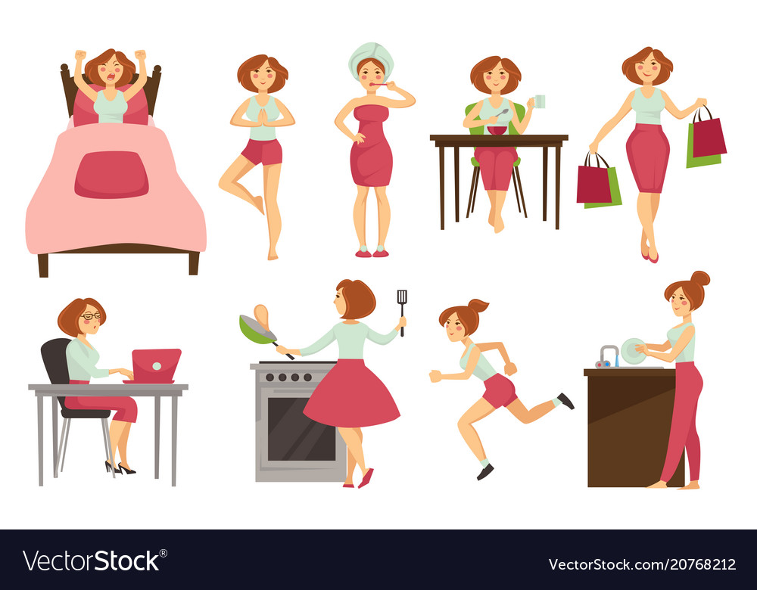
1) For verbs that end in: -o, -ch, -sh, -ss, -x, and -z we add -es to the verb in the third person.
go – goes
catch – catches
wash – washes
kiss – kisses
fix – fixes
/z/
she goes…
she catches…
she washes…
she kisses…
she fixes…
es
/Iz/
Pronounced

Slide 10
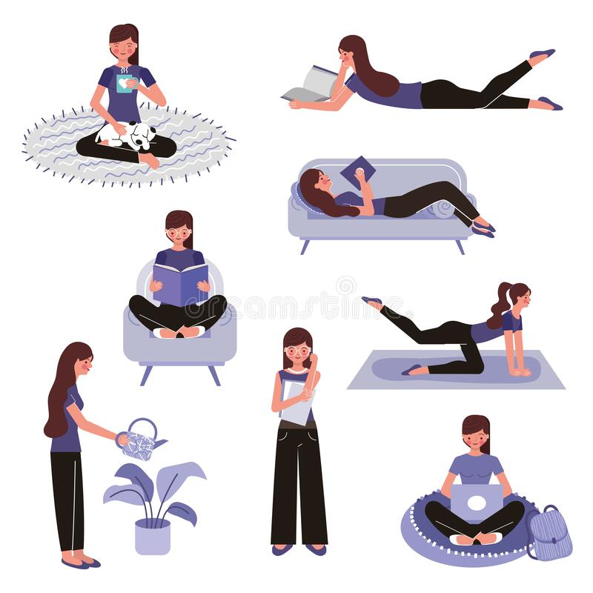
2. For verbs that end in a consonant + Y, we remove the ”y” and add -”ies”.
consonant
marry – marries
study – studies
carry – carries
worry – worries
She marries…
She studies…
She carries…
She worries…

Slide 11

For verbs that end in a vowel + Y, we just add -S.
vowel
play – plays
enjoy – enjoys
say – says
He plays…
He enjoys…
He says…

Slide 12
Negative Sentences in the Simple Present Tense
To make a negative sentence in English we normally use: “do not” or “don’t” (I, you, we, they)
→ and “does not” or “doesn’t” (he, she, it) , with all verbs EXCEPT To Be.
Look at the examples:
Third person singular
Affirmative: You speak French.
But… Negative: You don't speak Japanese.
Affirmative: Mary speaks Spanish.
But… Negative: She doesn't speak Chinese.
“don’t” (negation) here.
“doesn’t” (negation) here.

Slide 13

You will see that we add “don’t” between the subject and the verb to make the negative sentence.
Remember: We use “don’t” when the subject is: I, you, we or they.
subject
verb
Affirmative: We speak English.
Negative: We don't speak Italian.
Negation (between the subject and the verb)

Slide 14

When the subject is: he, she or it, we add “doesn’t” between the subject and the verb to make a negative sentence.
subject
verb (with “s”)
Affirmative: She speaks German.
Notice that the letter ‘S’ at the end of the verb (3rd person singular) in the affirmative sentence disappears in the negative sentence.
It is in the auxiliary “does”
Negative: She doesn't speak German.
“s” in the negation
Verb simple form
Remember: the negation (doesn’t) between the subject and the verb.

Slide 15
Word Order of Negative Sentences
1
2
3
4
Subject | Auxiliary: don't/doesn't | Verb* | the Rest of the sentence
I / you / we / they | don't | have / buy eat / like, etc. | cereal for breakfast
he / she / it | doesn’t
the verb in simple form
Notice that the “s” is in the auxiliary ‘doesn’t’ for the negation (3rd person singular). So it is not necessary to add it to the verb.

Slide 16

Let’s see more examples of Negative Sentences with don't and doesn't:
You don't speak Arabic.
John doesn't speak Italian. (he)
We don't have time for a rest.
The door doesn't move. (it)
My friends don't want to go to the party. (they)
My mom doesn't like fish. (she)
Paul and Carol don’t know the answer. (they)
The third person singular!

Slide 17

Questions in the Simple Present Tense:
How do we ask questions in the Simple Present Tense?
To make a question in English we normally use the auxiliaries: “do” and “does”.
These auxiliaries have no translation in Spanish however, they are necessary to show we are making a question.
When we ask ‘Yes/No’ questions, “do” and “does” is normally put at the beginning of the question.
We use ‘do’ when the subject is I, you, we or they.
We use ‘does’ when the subject is he, she, or it.

Slide 18
Let’s see some examples or Yes/No questions:
Affirmative sentences:
Let’s make them: Yes/No questions:
You need a dictionary.
Mary needs a dictionary.
We have a meeting now.
It rains a lot in winter.
They want to go to the party.
Paul likes pizza.
Do you need a dictionary?
Does Mary need a dictionary?
Do we have a meeting now?
Does it rain a lot in winter?
Do they want to go to the party?
Does Paul like pizza?
Notice we start the question with the auxiliary: do or does.

Slide 19
The following is the word order to construct a basic question in English using: Do or Does.
1
2
3
4
Do / Does | Subject | Verb* | The Rest of the sentence
Do | I / you / we / they | have / need want, etc. | a new bike?
Does | he / she / It
Notice that the “s” is in the auxiliary ‘does’ for the 3rd person singular. So it is not necessary to add it to the verb.

Slide 20
Do we use auxiliaries “do” and “does” for answers?
Well…. Yes! But only if the answers are “short answers”!
What are “short answers”?

Slide 21
Short answers are answering in a way that summarize the information.
Let’s see a few examples:
Do you like pizza?
You can give a long answer.
Yes. I like pizza.
Yes, I do.
The auxiliary: do… summarizes this information.
Or: you can give a short answer.
Or:
You can give a short negative answer.
You can give a long negative answer.
No, I don’t like pizza.
No, I don’t.
Period here.

Slide 22
Short answers for the third person singular (with auxiliary ‘does’)
This is a long affirmative answer. Remember to add ‘s’ to the verb
Does your sister like pizza?
Yes, she likes pizza.
Yes, she does.
Remember the auxiliary ‘does’ substitutes the information in a long answer.
This is a short affirmative answer.
This is a long negative answer. Remember: it’s not necessary to add ‘s’ to the verb
No, she doesn’t like pizza.
No, she doesn’t.
This is a short negative answer.
Period here.

Slide 23
Remember: We use the auxiliaries: ‘do’ and ‘does’ to give “Short Answers”.
In questions that use ‘do’ at the beginning (Yes/No questions) – (for: I, you, we, they), it is possible to give short answers to direct questions as follows:
Sample Questions | Short Answer (Affirmative) | Short Answer (Negative)
Do you like chocolate? | Yes, I do. | No, I don't.
Do I need a pencil? | Yes, you do. | No, you don't.
Do you both like chocolate? | Yes, we do. | No, we don't.
‘you both’ means 2 people (plural)
So… in the answer you and another person: ‘we’

Slide 24
We also use the auxiliary ‘does’ to give “Short Answers” for he, she, and it.
In questions that use ‘does’ at the beginning (Yes/No questions) – (for: he, she, it), it is possible to give short answers to direct questions as follows:
Sample Questions | Short Answer (Affirmative) | Short Answer (Negative)
Does he like chocolate? | Yes, he does. | No, he doesn't.
Does she like chocolate? | Yes, she does. | No, she doesn't.
Does it have four wheels? | Yes, it does. | No, it doesn't.

Slide 25
Information Questions in the Simple Present Tense
When we ask ‘Information’ questions, we start the question with words such as:
who, when, what, where, why, which or how.
“do” and “does” is normally after these words… and before the subject.
Yes/No question:
Do you study English?
Information question:
Where do you study English?
Look at the correct order:
(Information word)
(auxiliary)
(Subject)
(extra information)

Slide 26
To sum up:
We use the auxiliaries do and does to:
→ Ask questions.
→ Give short answers.
→ Give negative long answers.
NOTE: to give affirmative long answers, we only use the verb without the auxiliaries.

Slide 27
Complete the sentences with the correct form of the verb in parentheses.
PRACTICE
Carolina __________ the dishes at night. (wash)
Charles __________ TV on Sunday. (watch)
My parents __________ dinner together. (cook)
My brother __________ his grandfather a lot. (miss)
Thomas __________ computers every day, he’s a technician. (fix)
Norman and Julie ____________ English at UTN. (study)
My mother __________ to the Mall on Saturday. (go)
Robert __________ Portuguese at the new institute. (study)

Slide 28
Complete the sentences with the correct auxiliary: ‘do’ or ‘does’.
__________ your wife wash the dishes at night?
__________ Monica like to watch TV on Sunday?
What __________ you usually cook for dinner?
Where __________ your grandfather work?
What time __________ your children go to sleep?
When ____________ your brothers study English?
__________ Ellen go to the Mall on the weekend?
How often __________ your brother study Portuguese?

Slide 29
Put the words in the correct order:
I - do - work - not – at night
Your mother - go - does - to - the - city - ? - every day
weekend - eat - I - sushi - every
live - where - do - ? - you
Melanie - play - does - guitar - the - not

Slide 30
Complete the Information questions for each sentence:
My sister works in a big company.
Where_________________________________________
My mother cooks delicious spaghetti.
What __________________________________________
I live in Alajuela downtown.
Where _________________________________________
My parents like to sing at the karaoke bar.
Where _________________________________________
The train arrives at 12:30 pm.
What time ______________________________________

Slide 31
Make Yes/No questions for each sentence:
Yes, Carolina speaks Chinese very well.
__________________________________________________
No, I don’t know the answer.
__________________________________________________
Yes, we study mathematics every day.
__________________________________________________
Yes, my sister travels to Europe very often.
__________________________________________________
Yes, they sometimes listen to music.
__________________________________________________

